Slide 1
Power to Power Rule for Exponents
Integrated Mathematics

Slide 2
Objective
Students will apply the power to a power rule of exponents in order to simplify an algebraic expression.
Students will apply the negative and zero exponent rules to calculate the product of two or three mathematical terms.

Slide 3
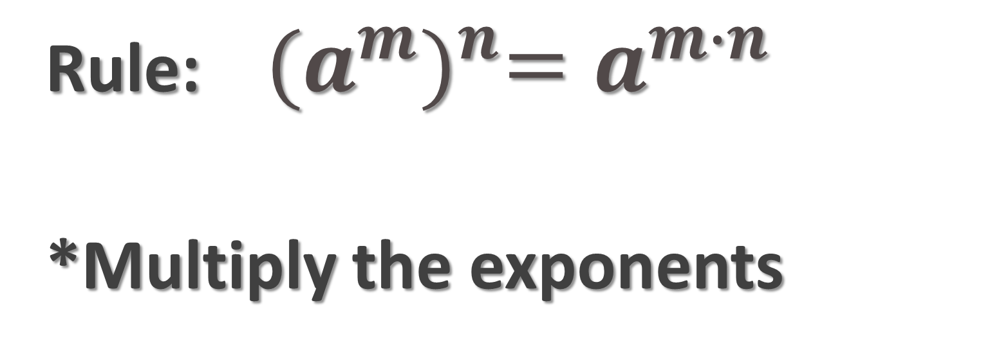
Raising a Power to a Power
Rule: ${(a^{m})}^{n}=a^{m∙n}$
*Multiply the exponents

Slide 4
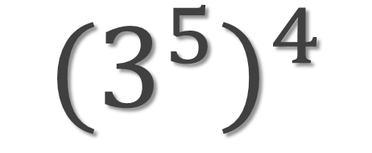
Example 1
$${(3^{5})}^{4}$$

Slide 5
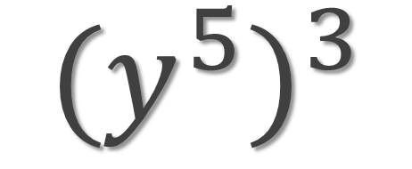
Example 2
$${(y^{5})}^{3}$$

Slide 6

Example 3
$${(a^{6})}^{3}$$

Slide 7

Example 4
$${(3yz^{4})}^{2}$$

Slide 8

Example 5
$${({−4x}^{3}yz^{3})}^{2}$$

Slide 9
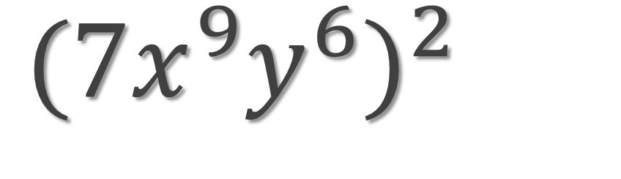
Example 6
${({7x}^{9}y^{6})}^{2}$

Slide 10
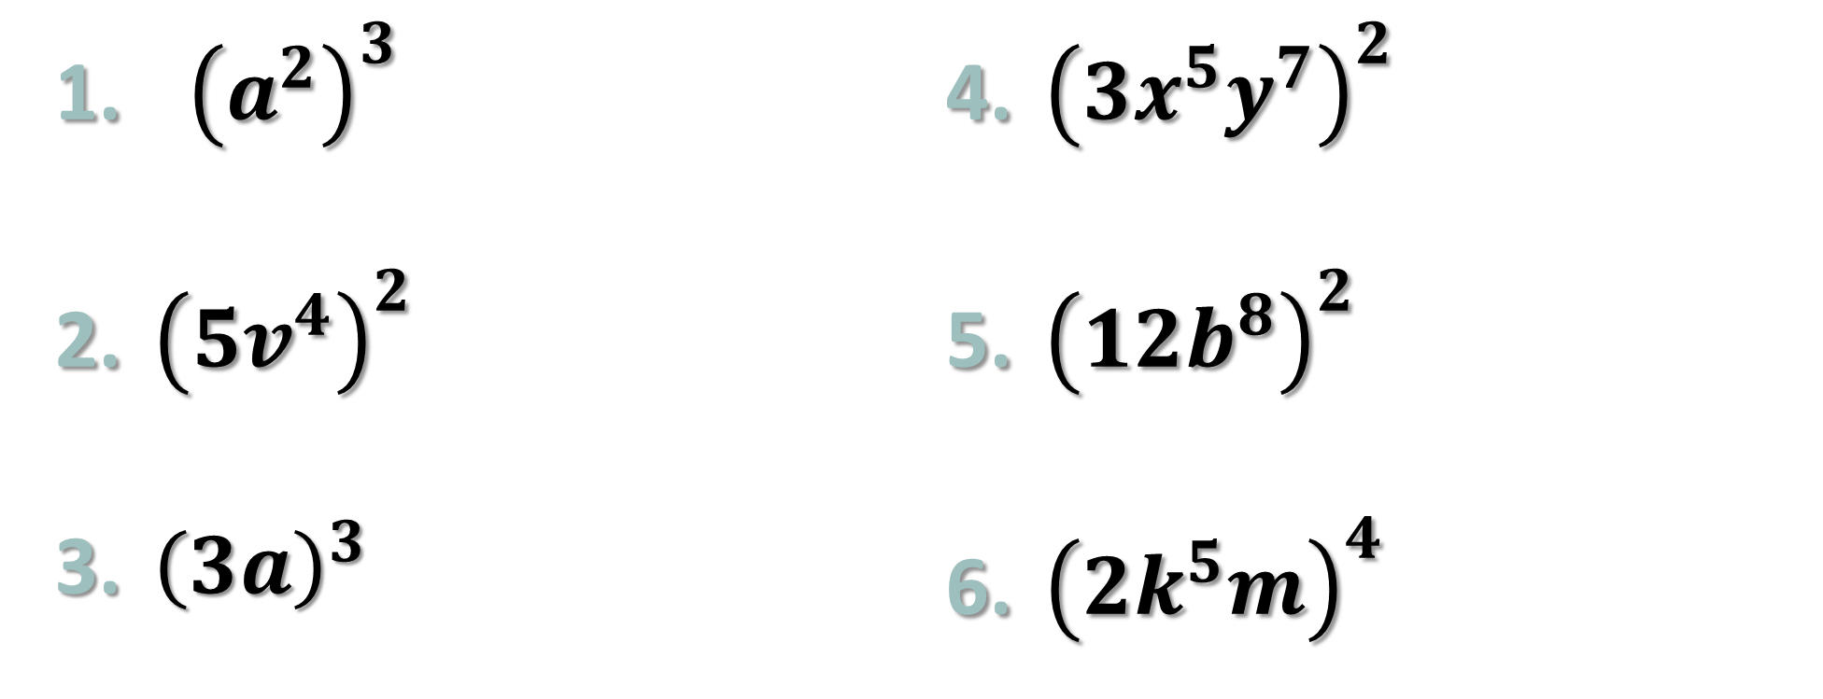
TRY THESE
${\left(a^{2}\right)}^{3}$
${\left({5v}^{4}\right)}^{2}$
${\left(3a\right)}^{3}$
${\left({3x}^{5}y^{7}\right)}^{2}$
${\left({12b}^{8}\right)}^{2}$
${\left(2k^{5}m\right)}^{4}$

Slide 11
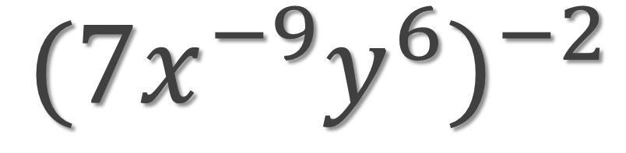
Example 7
${({7x}^{−9}y^{6})}^{−2}$

Slide 12
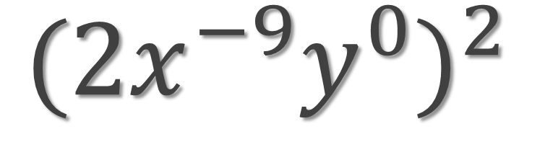
Example 8
${({2x}^{−9}y^{0})}^{2}$

Slide 13
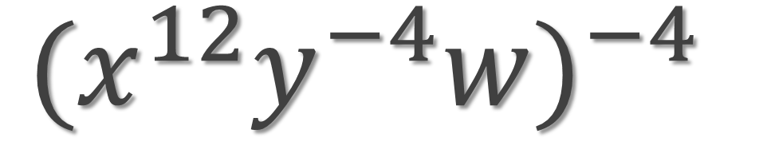
Example 9
${(x^{12}y^{−4}w)}^{−4}$

Slide 14
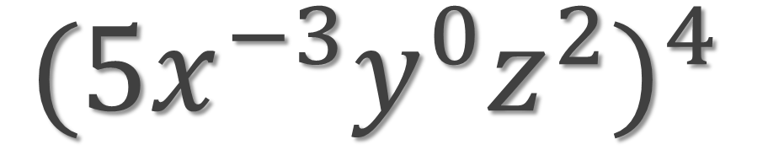
Example 10
${({5x}^{−3}y^{0}z^{2})}^{4}$

Slide 15
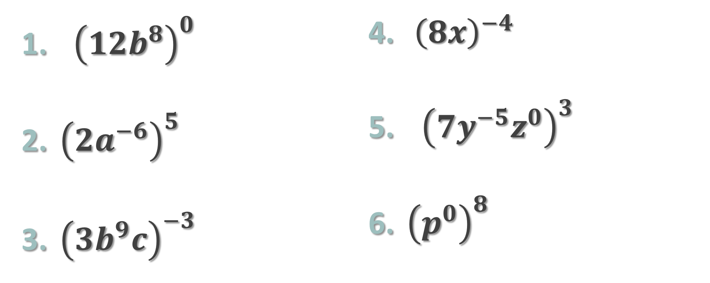
TRY THESE
${\left({12b}^{8}\right)}^{0}$
${\left({2a}^{−6}\right)}^{5}$
${\left({3b}^{9}c\right)}^{−3}$
${\left(8x\right)}^{−4}$
${ \left({7y}^{−5}z^{0}\right)}^{3}$
${\left(p^{0}\right)}^{8}$

Slide 16
Objective
Students will apply the power to a power and multiplication rules of exponents in order to simplify an algebraic expression.
Students will apply the negative and zero exponent rules to calculate the product of two or three mathematical terms.

Slide 17
Steps to Solving Mixed Problems
Think PEMDAS!!!!!
Apply Power to Power Rule
  Multiply Exponents/ Simplify Coefficients
Apply Multiplication Rule
  Add Exponents (Small Numbers)/ Multiply the
  Coefficients (Big Numbers)

Slide 18
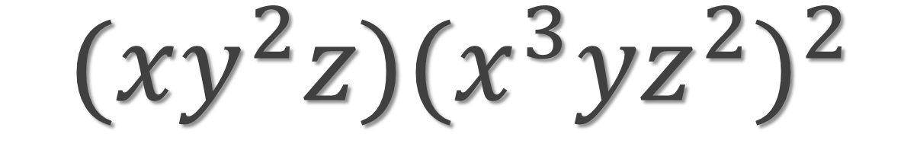
Example 11
$${(xy^{2}z)(x^{3}yz^{2})}^{2}$$

Slide 19
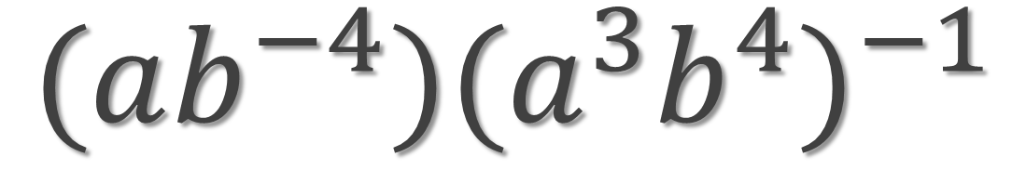
Example 12
${(ab^{−4})(a^{3}b^{4})}^{−1}$

Slide 20
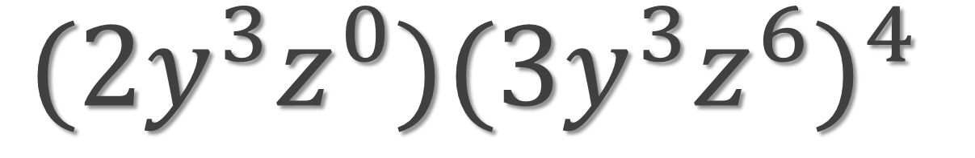
Example 13
${(2y^{3}z^{0})(3y^{3}z^{6})}^{4}$

Slide 21
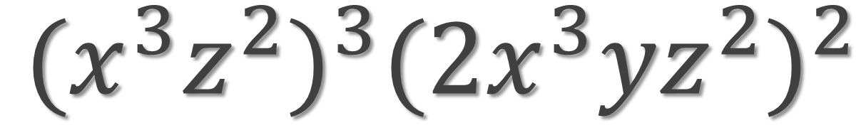
Example 14
${{(x^{3}z^{2})}^{3}({2x}^{3}yz^{2})}^{2}$

Slide 22
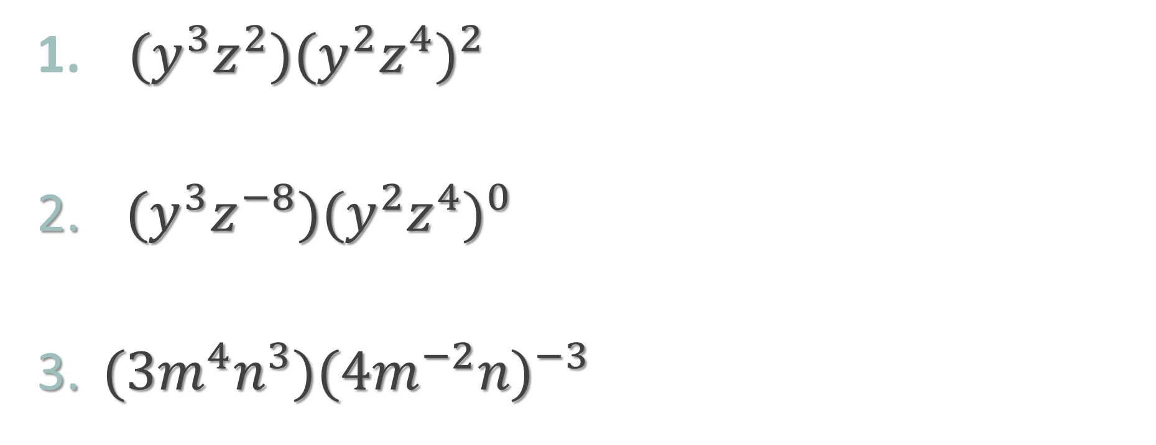
Practice
$(y^{3}z^{2}){(y^{2}z^{4})}^{2}$
$(y^{3}z^{−8}){(y^{2}z^{4})}^{0}$
$(3m^{4}n^{3}){({4m}^{−2}n)}^{−3}$

